Slide 1
Infrastructure as Code
and Terraform

Slide 2
Infrastructure as Code

Slide 3
What is Infrastructure as Code
Infrastructure as code (IaC) is the process of managing and provisioning computer data centers through machine-readable definition files, rather than physical hardware configuration or interactive configuration tools
The IT infrastructure managed by this process comprises both physical equipment, such as bare-metal servers, as well as virtual machines, and associated configuration resources
The definitions may be in a version control system
The code in the definition files may use either scripts or declarative definitions, rather than maintaining the code through manual processes, but IaC more often employs declarative approaches

Slide 4
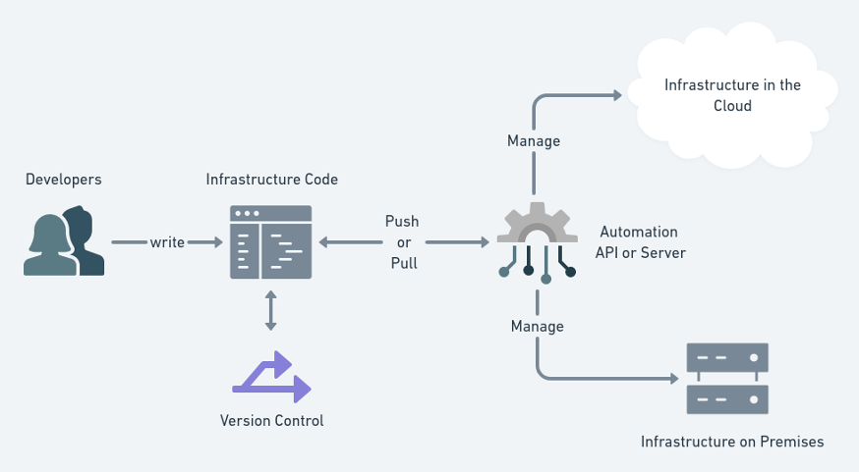
Infrastructure as Code

Slide 5
Before IaC
Manually managing a server or two has been a full-time job for decades
In many cases, we managed physical hardware in local or remote datacenters
Alternatively, a virtualization layer was built on top of that physical hardware
Even from the early days the cloud had infrastructure configuration services (like CloudFormation in AWS) but it felt complex and was not widely used
Requests to create VMs, add disks, expand disks, setup network, add K8s clusters, node K8s workers all this was done manually

Slide 6
What changed?
Shift from the datacenters to the cloud
DevOps & Agile, virtualization and the Cloud have shortened s/w development cycles, affecting infrastructure
Nowadays, engineers can need a dozen or a hundred servers for their workloads
Microservices introduced a ton of separate tools with their own needs for infrastructure
SCALE

Slide 7
Benefits of IaC
Price
Consistency
Speed
Documentation
Visibility
Troubleshooting
Common tooling
Scalability
Lower risk

Slide 8
Importance of IaC
DevOps without IaC | DevOps with IaC
Manual setup phases for each deployment | Codes are used to specify configurations and reused them.
Teardowns and deployments are slow | Teardowns and deployments are instant
Setups (hardware and software) are prone to errors | Setups are stored in version control.
Best practices are documented | Best practices are written inside the code
Troubleshooting and manual work is required for rollbacks | Simple and instant rollbacks

Slide 9
IaC: Imperative vs Declarative
Imperative
Define the steps to execute in order to reach the desired solution
Closer to how a human thinks - a series of steps
Can go into detail / has more control
Declarative
Define the desired state of the final solution, and the automation platform determines how to achieve that state
Since we only define the state of the final configuration, the complexity is hidden from the user
Idempotent: can be executed multiple times with the same result

Slide 10
Types of IaC
Scripting
Configuration management tools
Provisioning tools
Containers and templating tools

Slide 11
IaC best practices
Little or no documentation
Version control all configuration files
Constantly test configurations
Modular approach

Slide 12
IaC tools
Terraform
Puppet
Chef
Ansible
AWS Cloudformation
Azure Resource Manager
Google Cloud Deployment Manager
Pulumi

Slide 13
Terraform

Slide 14
What is Terraform?
HashiCorp Terraform is an infrastructure as code tool that lets you define both cloud and on-prem resources in human-readable configuration files that you can version, reuse, and share.
You can then use a consistent workflow to provision and manage all of your infrastructure throughout its lifecycle.
Terraform can manage low-level components like compute, storage, and networking resources, as well as high-level components like DNS entries and SaaS features.

Slide 15
Terraform key features
Infrastructure as Code
Execution plans
Resource Graph
Change Automation

Slide 16
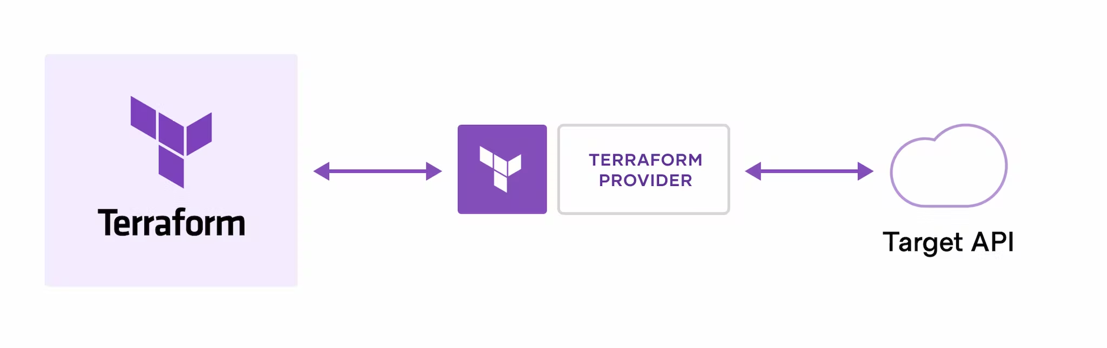
Terraform: how it works
Creates and manages resources on cloud platforms and other services via their APIs.
Providers enable TF to work with any platform with an API

Slide 17
Terraform workflow
Write: define resources
Plan: TF creates execution plan
Apply: TF performs the operations in proper order

Slide 18
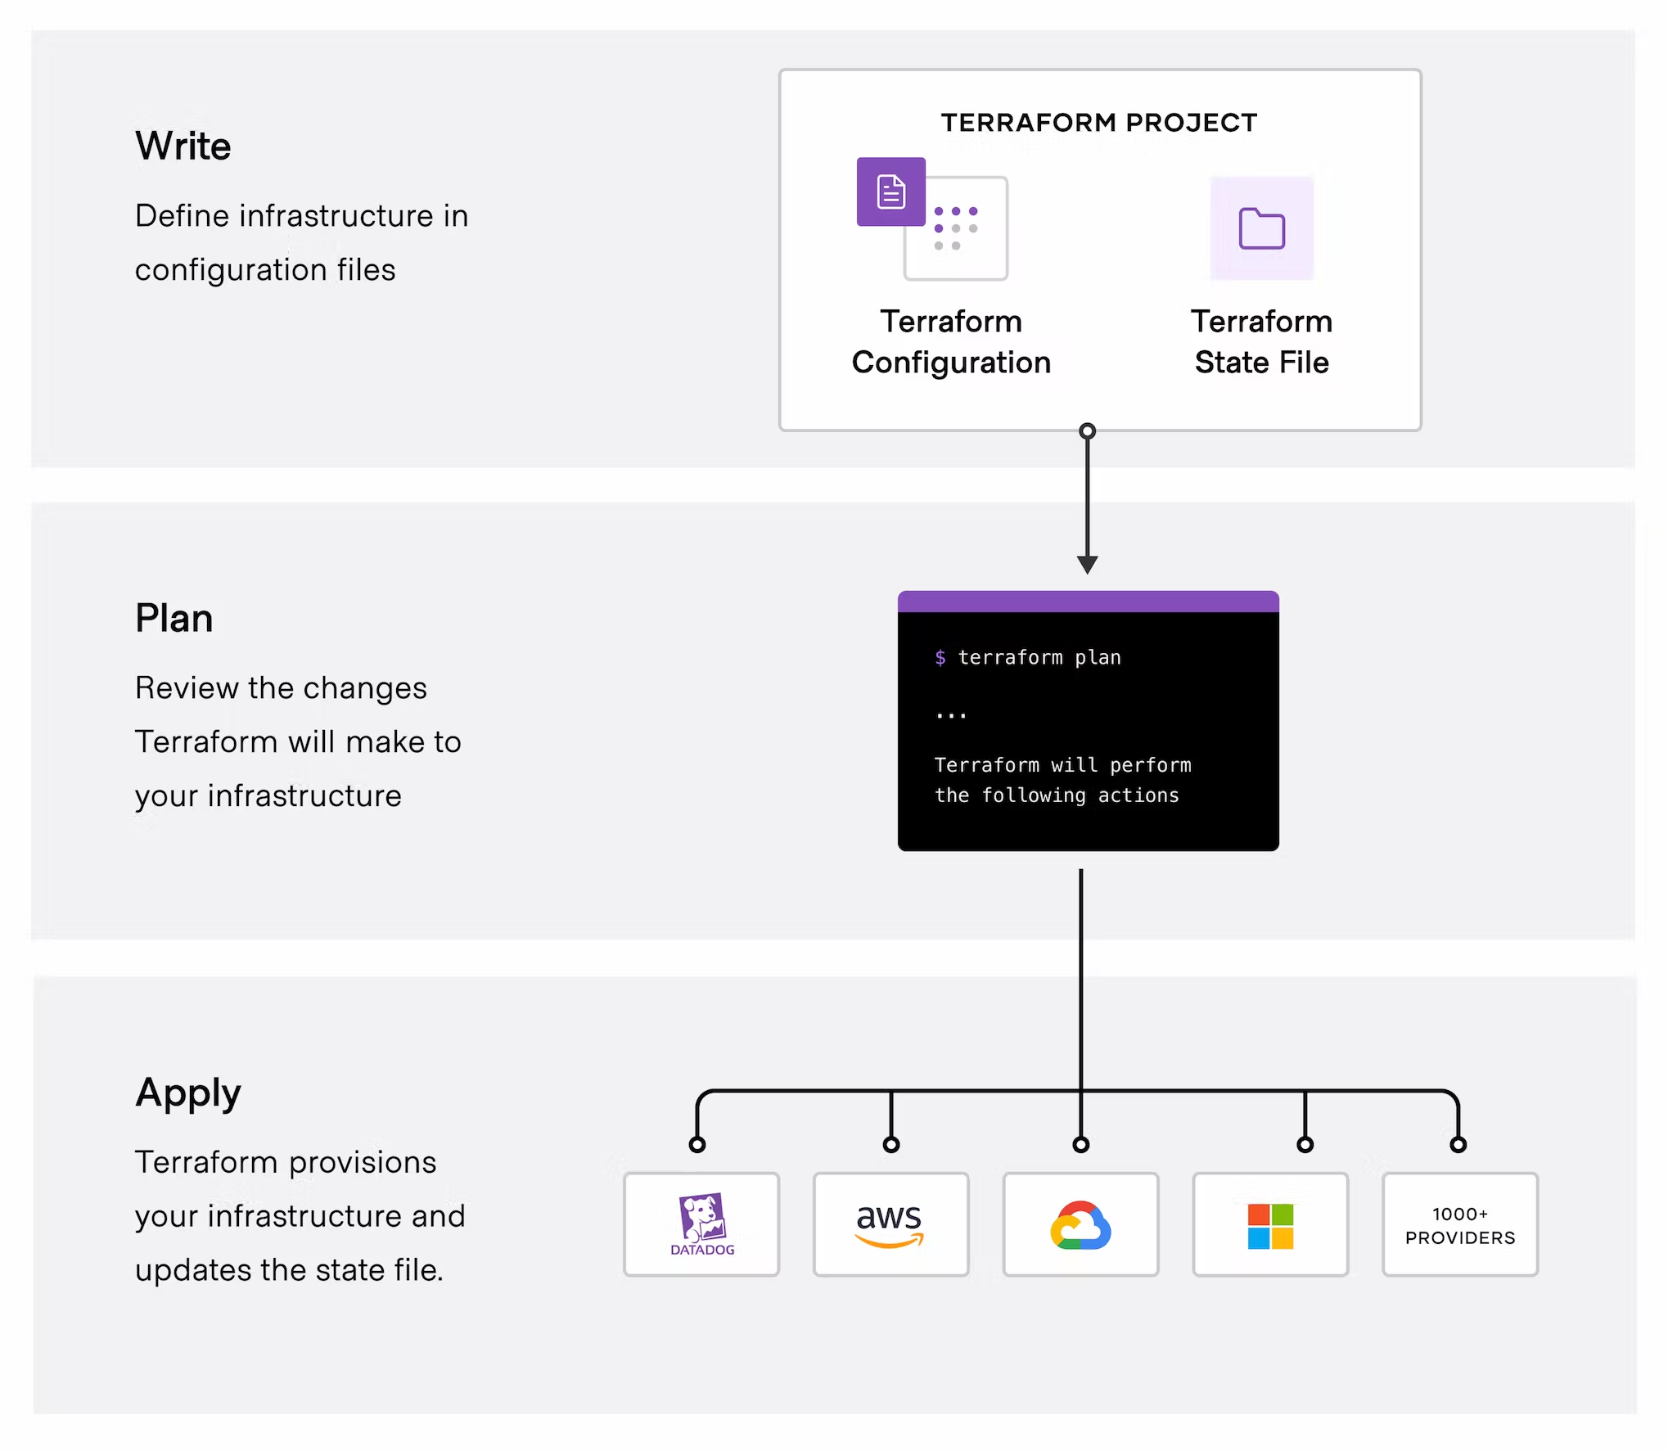

Slide 19
Terraform language
Purpose: declare resources which represent infrastructure objects
Configuration can consist of multiple files and directories
Declarative language
describes intended goal
order is not significant
TF considers implicit & explicit relationships to define order

Slide 20
Terraform language
Blocks represent configuration for some kind of object, like a resource
Have a ‘block type’
Zero or more labels
Have a ‘body’ with any number of arguments and nested blocks
Arguments assign a value to a name
They appear in blocks
Expressions represent a value
Literal definition or by referencing and combining other values
Appear as values for arguments

Slide 21
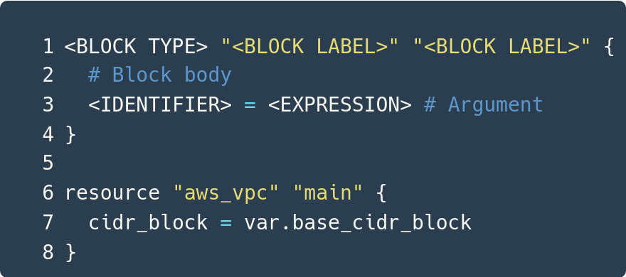

Slide 22
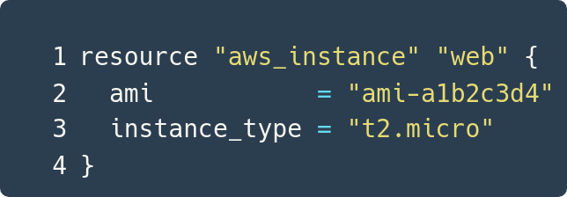
Terraform Resources
Resources are the most important element in TF language
They describe infrastructure objets
Syntax: resource <type> <name> { … }

Slide 23
Terraform State
Terraform State maps real world resources to our configuration
Keeps track of metadata
Improves performance for large infrastructures
Stored locally as “terraform.tfstate” or remotely

Slide 24
Terraform Resource Behavior
Creating a resource block saves a pointer to the real object in Terraform’s state
For existing resources in TF state, their status is compared with their resource definition and if necessary they are updated
In summary when applying TF configuration we will:
Create resources that exist in the configuration but are not associated with a real infrastructure object in the state
Destroy resources that exist in the state but no longer exist in the configuration
Update in-place resources whose arguments have changed
Destroy and re-create resources whose arguments have changed but which cannot be updated in-place due to remote API limitations

Slide 25
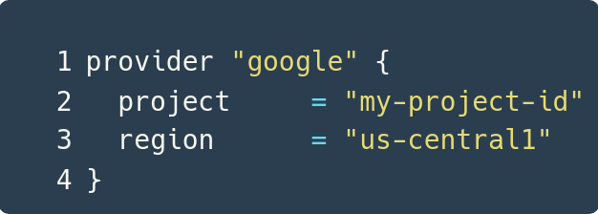
Terraform Providers
Each resource type is implemented by a provider
Provider is a TF plugin that offers a collection of resource types
Providers usually manage a single cloud / on-prem infrastructure platform, like Google provider

Slide 26
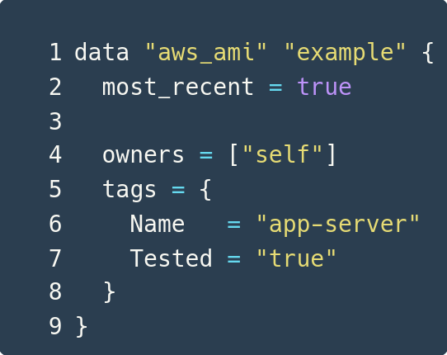
Terraform Data Sources
Data sources allow Terraform to use information defined outside of Terraform, defined by another separate Terraform configuration, or modified by functions

Slide 27
Terraform Meta-arguments
depends_on
count
foreach
provider
lifecycle

Slide 28
Terraform Modules
Modules are containers for multiple resources used together
Collection of .tf and / or .tf.json files together in a directory
Main way to package and reuse resource configurations in TF

Slide 29
Terraform Variables and Outputs
Input variables: parameters for a TF module
Output Values: return values for TF modules
Local Values: convenience feature for assigning a short name to an expression

Slide 30
Terraform Expressions and Functions
Terraform supports expressions:
Can be literal values like ‘5’ or ‘my-namespace’
Can be complex expressions like references to resource attributes or data sources
Include ‘for’ loops and conditional expressions
The Terraform language has a number of built-in functions
Transform and combine values
Similar to operators
Syntax like: <FUNCTION NAME>(<ARGUMENT 1>, <ARGUMENT 2>)

Slide 31
